Slide 1












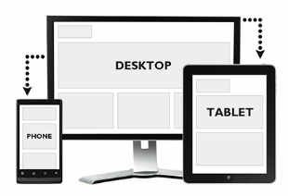







Local server
Front end
Editors
Server space
FTP server

Slide 2


What is the DOM
1
2
You can give orders to the boxes
It work with tags that contain tags </>
Class or Id
3
4
2
2
3
3
4
4

Slide 3
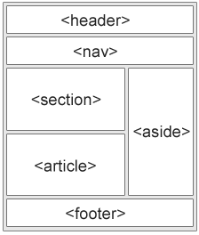
HTML is a system that trough tags and properties manage blocks of information that the users will see on in witch user can put information.
Events
Style atribute
They work like if it was java
The conection with css
XHTML
You can nest elements, it is the place to connect all the pages
Sintax
atributes
<></>
< element attribute = “ection”;>
<div style = “color:blue;”>
Id
Class
Href
width="104" height="142">
Tags – elements
Line and block elements
Entities/simbol
<></>
<>
Unicode - UTF-8
<form><form/>
Structure tags
<head><head/>
<body></body>
<foot></foot>
Linck tags tags
<link><link/>
<script></script>
<style></style>
Media
Video
Audio
Images
Text tag
<h1>
<p>
<table>
<a>
API
<embed>, <object>
Graphic design
<canvas>
<svg>
<div></div>
<span></span>
Youtube
Geo-location
Drag – and Drop
localstorage
<youCanCreateNames>
<youCanCreateNames />
Shiv Solution

Slide 4
Html
‘’ and “” are the same but use for diferentiate
It works with tags
Atribute
<!DOCTYPE html>
<html lang="en-US">
<head>
<meta name="description" content="Free Web tutorials on HTML and CSS">
<title>Page Title</title>
</head>
<body>
<h1><br>This</br> is a <hr>Heading</hr></h1>
<p>This is a paragraph.</p>
<!– i am aweosme -->
</body>
</html>
<!DOCTYPE html>
Href
Src
Width
Height
Alt
Title
Style
id
<img src="w3schools.jpg" width="104" height="142">
Links
Image
<a href="http://www.w3schools.com">This is a link</a>
<a href="http://www.w3schools.com/" target="_blank">Visit W3Schools!</a>
you want to go
<img src="w3schools.jpg" alt="W3Schools.com" width="104" height="142">
Awesome invisible bookmark to link diferent parts of the page
<a id="tips">Useful Tips Section</a>
you click to go
<map> - to click a specific part of an image
<a href="#tips">Visit the Useful Tips Section</a>|
Talk about types jpg, png, gif

Slide 5
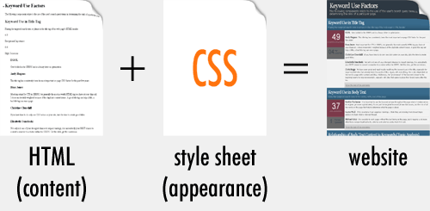
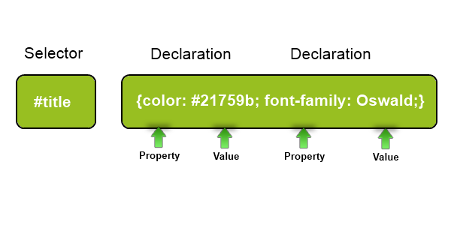
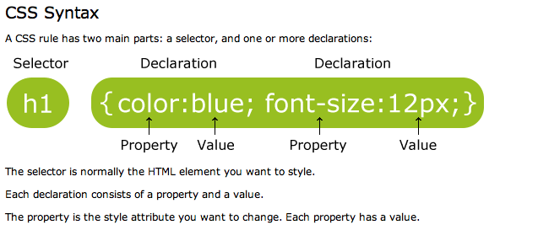

Slide 6

Priority
The basic CSS
Multiple selectors
body { background-color: #d0e4fe; } h1 { color: orange; text-align: center; } p { font-family: "Times New Roman"; font-size: 20px; }
/* This is a comment */
h1, h2, p { text-align: center; color: red; }
The class
The Id
.center { text-align: center; color: red; }
<Doctype html>
<p id="para1“> aweosme </p>
<style>
#para1 { text-align: center; color: red; }
Only affects the specific selectors
p.center { text-align: center; color: red; }

Slide 7
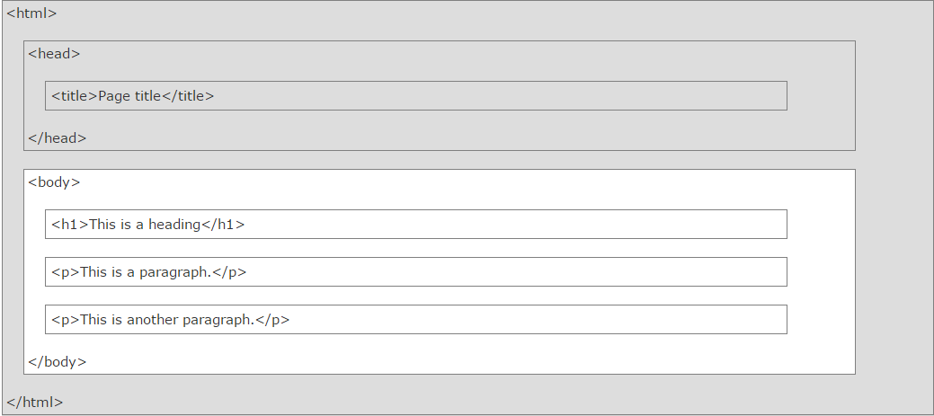
This is how the computer interprets HTML5, what you see on the web is the white part
<head> <link rel="stylesheet" type="text/css" href="mystyle.css"> </head>
This is how we link files
<script> | Defines a client-side script
<noscript> | Defines an alternate content for users that do not support client-side scripts

Slide 8
The cool and useful tags
<pre></pre> -- like a super <p></p>
Atributes
Tag | Description
<b> | Defines bold text
<em> | Defines emphasized text
<i> | Defines italic text
<small> | Defines smaller text
<strong> | Defines important text
<sub> | Defines subscripted text
<sup> | Defines superscripted text
<ins> | Defines inserted text
<del> | Defines deleted text
<mark> | Defines marked/highlighted text
Style
<body style="property:value“ > </body>
Style css properties
<abbr> | Defines an abbreviation or acronym
<address> | Defines contact information for the author/owner of a document
<bdo> | Defines the text direction
<blockquote> | Defines a section that is quoted from another source
<dfn> | Defines the definition of a term or an abbreviation.
<q> | Defines a short inline quotation
<cite> | Defines the title of a work
Use the style attribute for styling HTML elements
Use background-color for background color
Use color for text colors
Use font-family for text fonts
Use font-size for text sizes
Use text-align for text alignmen
Entity

Slide 9
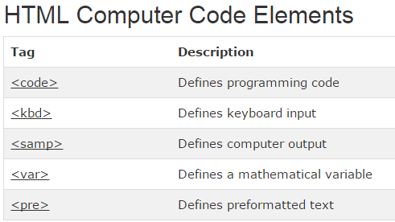
Tag | Description
<iframe> | Defines an inline frame
<base> | Defines a default address or a default target for all links on a page

Slide 10
Table and list
Tag | Description
<table> | Defines a table
<th> | Defines a header cell in a table
<tr> | Defines a row in a table
<td> | Defines a cell in a table
<caption> | Defines a table caption
<colgroup> | Specifies a group of one or more columns in a table for formatting
<col> | Specifies column properties for each column within a <colgroup> element
<thead> | Groups the header content in a table
<tbody> | Groups the body content in a table
<tfoot> | Groups the footer content in a table
<table style="width:100%"> <tr> <td>Jill</td> <td>Smith</td> <td>50</td> </tr> <tr> <td>Eve</td> <td>Jackson</td> <td>94</td> </tr> </table>
<th> can also use table head
<caption> can also put a caption , at the beginning
Tag | Description
<ul> | Defines an unordered list
<ol> | Defines an ordered list
<li> | Defines a list item
<dl> | Defines a description list
<dt> | Defines the term in a description list
<dd> | Defines the description in a description list
<dl> <dt>Coffee</dt> <dd>- black hot drink</dd> <dt>Milk</dt> <dd>- white cold drink</dd> </dl>

Slide 11
The most efficient way to style a block is by using div elements and together with class and id properties
Block like <div>or inline element like <span>
<di> </div>
<span></<span>

Slide 12
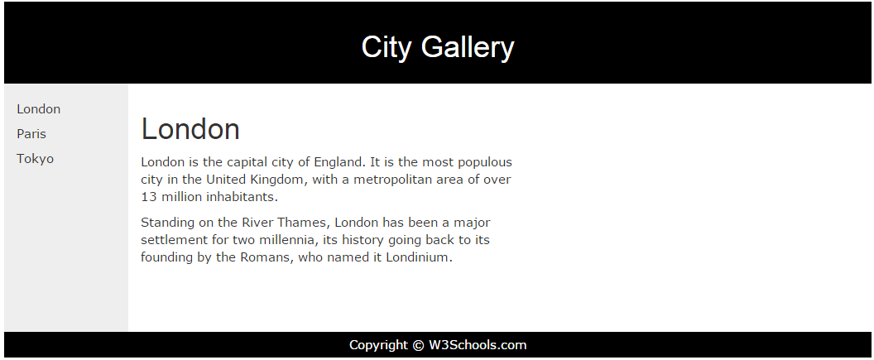
Classes
A class or is a html attribute that using ccs makes easy to give a standard style to a page
.cities { background-color:black; color:white; margin:20px; padding:20px; }
span.red {color:red;}
In HTML
<div class="cities">

Slide 13
Resposive web design
http://www.w3schools.com/html/html_responsive.asp
Two main components
To float things
And to percentage things

Slide 14
Adobe CC color
https://color.adobe.com/es/

Slide 15
http://designmodo.com/startup/

Slide 16
Form, imput element --- action , type attribute
<!DOCTYPE html>
<html>
<body>
<form action="action_page.php">
<fieldset>
<legend>Personal information:</legend>
First name:<br>
<input type="text" name="firstname" value="Mickey">
<br>
Last name:<br>
<input type="text" name="lastname" value="Mouse">
<br><br>
<input type="submit" value="Submit">
<select name="cars">
<option value="volvo">Volvo</option>
<option value="saab">Saab</option>
<option value="fiat">Fiat</option>
<option value="audi">Audi</option>
</select>
<textarea name="message" rows="10" cols="30"> The cat was playing in the garden. </textarea>
<button type="button" onclick="alert('Hello World!')">Click Me!</button>
</fieldset>
</form>
</body>
</html>
<form action="action_page.php" method="GET" target="_blank" accept-charset="UTF-8" enctype="application/x-www-form-urlencoded" autocomplete="off" novalidate> . form elements . </form>

Slide 17
Forms – new elements
Tag | Description
<form> | Defines an HTML form for user input
<input> | Defines an input control
<textarea> | Defines a multiline input control (text area)
<label> | Defines a label for an <input> element
<fieldset> | Groups related elements in a form
<legend> | Defines a caption for a <fieldset> element
<select> | Defines a drop-down list
<optgroup> | Defines a group of related options in a drop-down list
<option> | Defines an option in a drop-down list
<button> | Defines a clickable button
<datalist> | Specifies a list of pre-defined options for input controls
<keygen> | Defines a key-pair generator field (for forms)
<output> | Defines the result of a calculation
HTML5 added several new input types:
color
date
datetime
datetime-local
email
month
number
range
search
tel
time
url
week

Slide 18
<canvas> and <svg> --- a container for graphics
<!DOCTYPE html>
<html>
<body>
<canvas id="myCanvas" width="200" height="100" style="border:1px solid #d3d3d3;">
Your browser does not support the HTML5 canvas tag.</canvas>
<script>
var c = document.getElementById("myCanvas");
var ctx = c.getContext("2d");
ctx.beginPath();
ctx.arc(95,50,40,0,2*Math.PI);
ctx.stroke();
</script>
</body>
</html>
<svg height="130" width="500"> <defs> <linearGradient id="grad1" x1="0%" y1="0%" x2="100%" y2="0%"> <stop offset="0%" style="stop-color:rgb(255,255,0);stop-opacity:1" /> <stop offset="100%" style="stop-color:rgb(255,0,0);stop-opacity:1" /> </linearGradient> </defs> <ellipse cx="100" cy="70" rx="85" ry="55" fill="url(#grad1)" /> <text fill="#ffffff" font-size="45" font-family="Verdana" x="50" y="86">SVG</text> Sorry, your browser does not support inline SVG. </svg>

Slide 19
<header>
<section>
<footer>
<aside>
https://github.com/afarkas/html5shiv
http://html5boilerplate.com/

Slide 20
<video>
<video width="320" height="240" autoplay> <source src="movie.mp4" type="video/mp4"> <source src="movie.ogg" type="video/ogg"> Your browser does not support the video tag. </video>
<audio controls> <source src="horse.ogg" type="audio/ogg"> <source src="horse.mp3" type="audio/mpeg"> Your browser does not support the audio element. </audio>

Slide 21
<iframe> <embed> and <object> from plog in or call other html page
<embed width="100%" height="500px" src="snippet.html">
<iframe width="420" height="315" src="http://www.youtube.com/embed/XGSy3_Czz8k?autoplay=1"> </iframe>

Slide 22
Geo location
getCurrentPosition()
Property | Description
coords.latitude | The latitude as a decimal number
coords.longitude | The longitude as a decimal number
coords.accuracy | The accuracy of position
coords.altitude | The altitude in meters above the mean sea level
coords.altitudeAccuracy | The altitude accuracy of position
coords.heading | The heading as degrees clockwise from North
coords.speed | The speed in meters per second
timestamp | The date/time of the response

Slide 23
Drag and drop – it is an attribute
<img draggable="true">
HTML Local Storage Objects
window.localStorage - stores data with no expiration date
window.sessionStorage - stores data for one session (data is lost when the tab is closed)

Slide 24
Manifesto Cache is for making webpages that load ofline
CACHE MANIFEST # 2012-02-21 v1.0.0 /theme.css /logo.gif /main.js NETWORK: login.asp FALLBACK: /html/ /offline.html
To say what should be load offline
To show what should never load, a * will mean everything else
NETWORK
*
The file should be called name.appcache
What to show id there is no connection
<!DOCTYPE HTML> <html manifest="demo.appcache"> ... </html>
Call Apache in HTML

Slide 25
HTML5 Web Workers

Slide 26
Html events

Slide 28
Priority
The basic CSS
Multiple selectors
body { background-color: #d0e4fe; } h1 { color: orange; text-align: center; } p { font-family: "Times New Roman"; font-size: 20px; }
/* This is a comment */
h1, h2, p { text-align: center; color: red; }
3 ways to add style to a HTML
External style sheet
Internal style sheet
Inline style
<head> <link rel="stylesheet" type="text/css" href="mystyle.css"> </head>
The class
The Id
.center { text-align: center; color: red; }
<Doctype html>
<p id="para1“> aweosme </p>
<style>
#para1 { text-align: center; color: red; }
Only affects the specific selectors
p.center { text-align: center; color: red; }

Slide 30
http://www.w3schools.com/css/tryit.asp?filename=trycss_image_gallery
The different types of selectors
general sibling selector
Div ~ p {}
all <p> elements that are siblings of <div> elements
Combinators
adjacent sibling selector
Div + p {}
<p> elements that are placed immediately after <div> elements
Div p { xx:xx;}
Div > p {xx:xx;}
Div + p {}
Div ~ p {}
Attribute Selectors
Id
#makeUpAName { xx:xx; }
class
.makeUpAName { xx:xx; }
descendant selector
Div p {}
selects all <p> elements inside <div> elements:
child selector
Div > p {}
<p> elements that are immediate children of a <div>
Eelement
P {xx:xx;}
a{}
Table{}
You can group elements
h1, h2, p { text-align: center; color: red; }
Class that only affects a specific element
p.makeUpAName { xx:xx; }
Pseudo-classes
Style that only act over characteristics of elements
selector:pseudo-class { property:value; }
Or
Selector.class:pseudo-class { property:value; }
::selection { color: red; background: yellow; }
Pseudo-elements
/* unvisited link */ a:link { color: #FF0000; } /* visited link */ a:visited { color: #00FF00; } /* mouse over link */ a:hover { color: #FF00FF;
} /* selected link */ a:active { color: #0000FF; }
h1::before { content: url(smiley.gif); }
p::first-letter { color: #ff0000; font-size: xx-large; }
P:first-child
a:hover
a:active
a:visited
selector::pseudo-element { property:value; }
p::first-line {}
Are already predefine in CSS you don’t make up the names

Slide 31
The CSS properties
Take into account that the editor can give you the options of the value of the property. Making important to know the properties by memory but not the values
Background
Text formatting
Link formatting
.body { background-color: #b0c4de; }
h1 { color: #00ff00;
font-size: 40px; }
a { color: #FF0000; }
p.date { text-align: right;
}
.body {
background-image: url("paper.gif");
}
font-size: 2.5em; /* 40px/16=2.5em */
/* unvisited link */ a:link { color: #FF0000;
background-color: #B2FF99; } /* visited link */ a:visited { color: #00FF00; } /* mouse over link */ a:hover { color: #FF00FF;
} /* selected link */ a:active { color: #0000FF; }
h2 { text-decoration: line-through; }
p { font-family: "Times New Roman", Times, serif; }
body { background-image: url("gradient_bg.png"); background-repeat: repeat-x; /* it could be also repeat-x to repeat the image over the vertical angle */ }
p.lowercase { text-transform: lowercase;
font-style: italic; }
a:hover MUST come after a:link and a:visited
a:active MUST come after a:hover
http://www.w3schools.com/css/css_text.asp -- you can go crazy and change event the space between letters

Slide 32
The CSS properties
Take into account that the editor can give you the options of the value of the property. Making important to know the properties by memory but not the values
List
Table
Link formatting
table, th, td { border: 1px solid black; }
ul.classa { list-style-type: circle; } ul.classb { list-style-type: square; }
table { border-collapse: collapse; } table, th, td { border: 1px solid black; }
ul { list-style-image: url('sqpurple.gif'); }
table { width: 100%; } th { height: 50px; }
th { text-align: left; }
http://www.w3schools.com/css/css_list.asp
td { height: 50px; vertical-align: bottom;
padding:15px; }

Slide 33
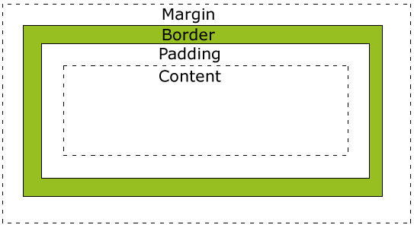
Block box model
div { width: 300px; padding: 25px; border: 25px solid navy; margin: 25px; }
div { width: 320px; padding: 10px; border: 5px solid gray; margin: 0; }

Slide 34
Block box model
Border
dotted , dashed, solid, double, groove, ridge, inset, outset
Outline
None of the border properties will have ANY effect unless the border-style property is set!
outline
p.one { border-style: solid; border-width: 5px;
border-color: #98bf21; } p.two { border-style: solid; border-width: medium; }
outline-color
p { border-top-style: dotted; border-right-style: solid; border-bottom-style: dotted; border-left-style: solid; }
outline-style
outline-width
The border-style property can have from one to four values.
border-style: dotted solid double dashed;
top border is dotted
right border is solid
bottom border is double
left border is dashed
border-style: dotted solid double;
top border is dotted
right and left borders are solid
bottom border is double
border-style: dotted solid;
top and bottom borders are dotted
right and left borders are solid
border-style: dotted;
all four borders are dotted
shorthand property.
p { border: 5px solid red; }

Slide 35

Block box model
Margin
Padding
p { margin-top: 100px; margin-bottom: 100px; margin-right: 150px; margin-left: 50px; }
p { padding-top: 25px; padding-right: 50px; padding-bottom: 25px; padding-left: 50px; }
margin: 25px 50px 75px 100px;
top margin is 25px
right margin is 50px
bottom margin is 75px
left margin is 100px
margin: 25px 50px 75px;
top margin is 25px
right and left margins are 50px
bottom margin is 75px
margin: 25px 50px;
top and bottom margins are 25px
right and left margins are 50px
margin: 25px;
all four margins are 25px
p { margin: 100px 50px; }
Short version works the same way
p { padding: 25px 50px; }

Slide 36
Block box model
Dimensions
Still affects the layout
Height
max-height
width
Visibility and display
Position like in a Cartesian , but inside its parent ex <div>
h1.hidden { visibility: hidden; }
Absolute Positioning
h1.hidden { display: none; }
Does nor affects the layout
Position
Relative Positioning
Static Positioning
Fixed Positioning
Overlapping Elements
li { display: inline; }
p.pos_fixed { position: fixed; top: 30px; right: 5px; }
Change an inline element to a line element used for navbars for example
img { position: absolute; left: 0px; top: 0px; z-index: -1; }
span { display: block; }
http://www.w3schools.com/css/css_positioning.asp

Slide 37
Block box model – float
1
2
.floating-box { float: left; width: 150px; height: 75px; margin: 10px; border: 3px solid #8AC007; }
IF float 3 to the left
3
4
It does not affect what is before only after
IF float 3 to the left
<div class = “floatright3”>
</div>
<div class = “floatleft4”>
</div>
The clear property specifies on which sides of an element floating elements are not allowed to float:
1
2
1
2
.div4 { clear: left; }
4
3
3
4

Slide 38
How to centre an element
1
.center { margin-left: auto; margin-right: auto; width: 70%; background-color: #b0e0e6; }
1
2
.right { position: absolute; right: 0px; width: 300px; background-color: #b0e0e6; }

Slide 39
Pseudo-classes
Go over list
http://www.w3schools.com/css/css_pseudo_classes.asp
Pseudo-elements
Go over list
http://www.w3schools.com/css/css_pseudo_elements.asp

Slide 40


Example of opacity
Images
http://www.w3schools.com/css/css_image_transparency.asp
img { opacity: 0.4; filter: alpha(opacity=40); /* For IE8 and earlier */ } img:hover { opacity: 1.0; filter: alpha(opacity=100); /* For IE8 and earlier */ }
#home a:hover { background: url('img_navsprites_hover.gif') 0 -45px; } #prev a:hover { background: url('img_navsprites_hover.gif') -47px -45px; } #next a:hover { background: url('img_navsprites_hover.gif') -91px -45px; }
Images Sprites
#home { width: 46px; height: 44px; background: url(img_navsprites.gif) 0 0; }

Slide 41
CSS [attribute] Selector
[attribute=value] Selector
[attribute~=value] Selector
[attribute|=value] Selector
[attribute^=value] Selector
[attribute$=value] Selector
[attribute*=value] Selector
Good for styling forms
CSS Attribute Selectors
a[target] { background-color: yellow; }
The following example selects all <a> elements with a target attribute:
a[target="_blank"] { background-color: yellow; }
<a> elements with a target="_blank" attribute
[title~="flower"] { border: 5px solid yellow; }
selects all elements with a title attribute that contains a space-separated list of words, one of which is "flower"
[class|="top"] { background: yellow; }
either alone, like class="top", or followed by a hyphen( - ), like class="top-text"! --- if ^ then can be just starting with top like topsomething
[class^="top"] { background: yellow; }
[class$="test"] { background: yellow; }
all elements with a class attribute value that ends with "test"
[class*="te"] { background: yellow; }
selects all elements with a class attribute value that contains "te"

Slide 42
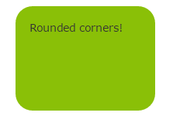
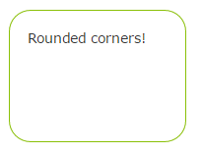
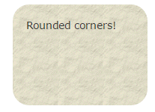
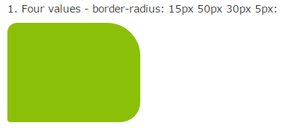
Css3 – cool and new
Background
Border
Background image
#rcorners1 { border-radius: 25px; background: #8AC007; padding: 20px; width: 200px; height: 150px; }
#rcorners2 { border-radius: 25px; border: 2px solid #8AC007; padding: 20px; width: 200px; height: 150px; }
#rcorners3 { border-radius: 25px; background: url(paper.gif); background-position: left top; background-repeat: repeat; padding: 20px; width: 200px; height: 150px; }
border-top-left-radius

Slide 43
Background image
http://www.w3schools.com/css/css3_backgrounds.asp

Slide 44

Gradients
To go from one colour to the other
background: linear-gradient(direction, color-stop1, color-stop2, ...);
#grad { background: -webkit-linear-gradient(red, blue); /* For Safari 5.1 to 6.0 */ background: -o-linear-gradient(red, blue); /* For Opera 11.1 to 12.0 */ background: -moz-linear-gradient(red, blue); /* For Firefox 3.6 to 15 */ background: linear-gradient(red, blue); /* Standard syntax */ }

Slide 45
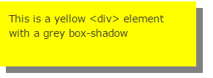

Shadows
h1 { text-shadow: 0 0 3px #FF0000; }
div { box-shadow: 10px 10px grey; }

Slide 46
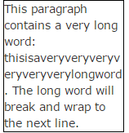
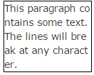
Some other text options
text-overflow
word-wrap
word-break

Slide 47
Put different fonts
@font-face { font-family: myFirstFont; src: url(sansation_light.woff); } div { font-family: myFirstFont; }

Slide 48
Animaitons on css
Go to the w3s
And open the examples
http://www.w3schools.com/css/css3_2dtransforms.asp
http://www.w3schools.com/css/css3_animations.asp

Slide 49
Dom

Slide 50
Github course
Git commands
Git status
Git init : to create a new git repository
Git add file_name : for staging – git add --all to add all the files
Git Commit –m “this is the new index” – to make the changes m is the message
Git log : show the commits of a path
Git log --graph --decorate --all --pretty=oneline – see commits as a tree
Git checkout identificationumber : to go back in time to a commit
Git checkout branchnmae to go to other branch
Git branch name – to create a new branch
git config --global user.name "Your Name“
git config --global user.email "your_email@whatever.com"
Git push data form local to online
Install and open git bash – this is a linux mashine
Commands
Pwd – to see position folder
Ls = “list” to see the list of all the files in a folder
Ls – a includes the hiddent files
cd – to go to a new repository – example ( the space is important -- cd /c/
Cd users/ will send to the folder users inside c
Clear – to clean the linux terminal
Mkdir nameofdirectory – to make a new directory
rm -r directory_name - to remove a directory
Rm remove file – example rm test.txt
cd.. Is go up one level
Git = to make sure git is there
Shift + q to exit a end in the terminal
https://www.youtube.com/watch?v=0fKg7e37bQE
http://rogerdudler.github.io/git-guide/
https://www.youtube.com/watch?v=DVDLoe_2MBc
https://www.youtube.com/watch?v=61WbzS9XMwk

Slide 51
git
1
2
3
Create a repository
Comand: git init
Staging
Put thing ready to be commited
Git add intex.html
Commit
Put thing ready to be commited
Git add intex.html

Slide 52
github
1
2
3
Create a repository
Create an account and go to the plus and create a online repository
Push changes
Put commited
Into git
Git push
Keep updted
Bring to your local what other team members have changed
Git pull
Connect the local repository with the github
git remote add origin https://github.com/flibijuan/shoppinglist.git
git push -u origin master

Slide 53
Git hub – conflict resolution
1
2
3
When pushing – github is going to ask for a pull first
Push changes
And git will answer this is an error and is going to enter into a merging mode
Solve the problem
Go to the editor look at the problem and then adter is fxied by hand
Git status
Git add –all
Git commit (without a message)
Then to tell it to continue press :wq or if it is a separate window just close it
Git push to make the changes

Slide 54
For other team members to connect to my project
1
2
3
Clone the online project into your computer
Push changes
Put commited
Into git
Git push
Keep updted
Bring to your local what other team members have changed
Git pull
Git clone url-of the project

Slide 55
Add colaborators
Project owner
Settings
Colaborators
Add friend

Slide 56
bootstrap
There are two container classes to choose from:
The .container class provides a responsive fixed width container
The .container-fluid class provides a full width container, spanning the entire width of the viewport
https://www.youtube.com/watch?v=2W03ZymI46g

Slide 57
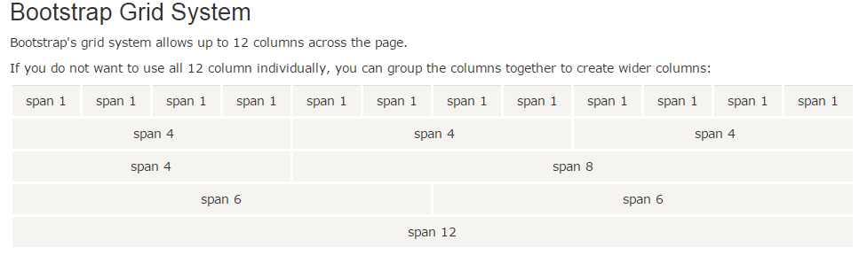

This is what makes the magic of the responsive design
First use a class row and then class Colum, the sum of the columns need to be 12
Push
Pull
To change the order of the greed in mobile or in web
<div class="row"> <div class="col-sm-4">.col-sm-4</div> <div class="col-sm-4">.col-sm-4</div> <div class="col-sm-4">.col-sm-4</div> </div>

Slide 58


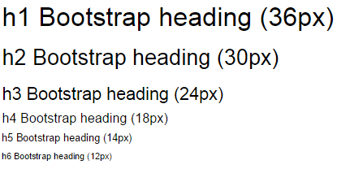

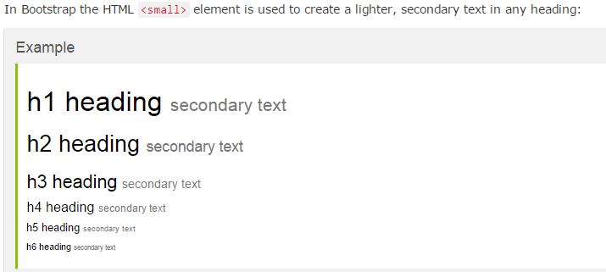
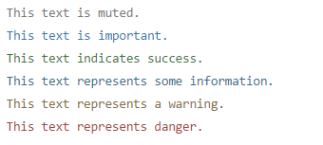
.text-muted, .text-primary, .text-success, .text-info, .text-warning, and .text-danger

Slide 59
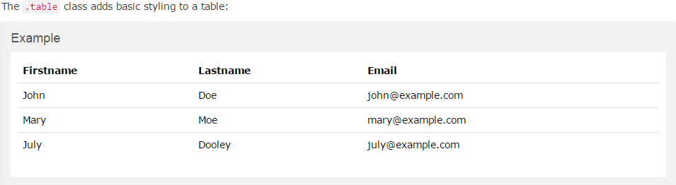
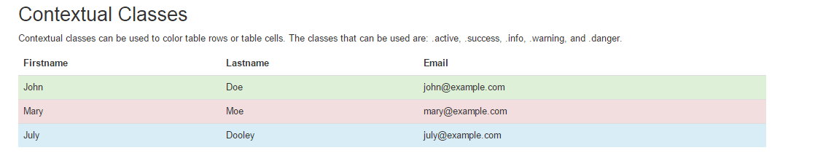
Bootstrap Basic Table
.table-striped
.table-bordered
.table-hover
.table-condensed
.active | Applies the hover color to the table row or table cell
.success | Indicates a successful or positive action
.info | Indicates a neutral informative change or action
.warning | Indicates a warning that might need attention
.danger | Indicates a dangerous or potentially negative action

Slide 60
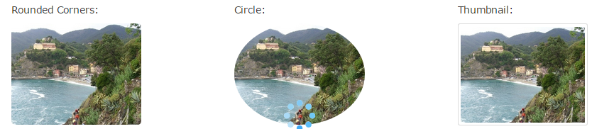
Image management
<img src="cinqueterre.jpg" class="img-rounded" alt="Cinque Terre" width="304" height="236">
We have to add class = “image responsive” to the img tag to make it responsive
<img src="cinqueterre.jpg" class="img-circle" alt="Cinque Terre" width="304" height="236">
<img src="cinqueterre.jpg" class="img-thumbnail" alt="Cinque Terre" width="304" height="236">

Slide 61

To scale up or down images or videos
<!-- 16:9 aspect ratio --> <div class="embed-responsive embed-responsive-16by9"> <iframe class="embed-responsive-item" src="..."></iframe> </div> <!-- 4:3 aspect ratio --> <div class="embed-responsive embed-responsive-4by3"> <iframe class="embed-responsive-item" src="..."></iframe> </div>

Slide 62
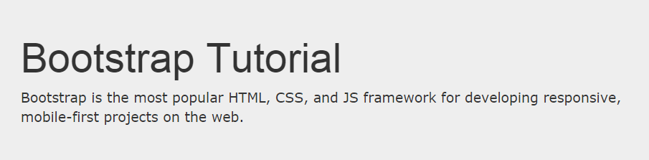
Bootstrap Jumbotron and Page Header
We first create a container class so that the jumbotron take the same dimensions , if we would like it to be full screen , then we put it out
<div class="container"> <div class="jumbotron"> <h1>Bootstrap Tutorial</h1> <p>Bootstrap is the most popular HTML, CSS, and JS framework for developing responsive, mobile-first projects on the web.</p> </div> <p>This is some text.</p> <p>This is another text.</p> </div>
<div class="page-header"> <h1>Example Page Header</h1> </div>

Slide 63
<div class="well well-sm">Small Well</div> <div class="well well-lg">Large Well</div>
Small or large

Slide 64
Alerts
.alert-success, .alert-info, .alert-warning or .alert-danger:
<div class="alert alert-success"> <strong>Success!</strong> Indicates a successful or positive action. </div>

Slide 65


Button class
There are 4 ways to create a button
.btn-lg
.btn-md
.btn-sm
.btn-xs
The button classes can be used on an <a>, <button>, or <input> element:
<button type="button" class="btn btn-default">Default</button> <button type="button" class="btn btn-primary">Primary</button> <button type="button" class="btn btn-success">Success</button> <button type="button" class="btn btn-info">Info</button> <button type="button" class="btn btn-warning">Warning</button> <button type="button" class="btn btn-danger">Danger</button> <button type="button" class="btn btn-link">Link</button>
The class .active makes a button appear pressed, and the class .disabled makes a button unclickable:
Add class .btn-block to create a block level button:

Slide 66

Button groups
http://www.w3schools.com/bootstrap/bootstrap_button_groups.asp
Go to linck
.btn-group-vertical
To make a group create a div and then put the buttons inside
.btn-group-large example
.btn-group-*
<div class="btn-group"> <button type="button" class="btn btn-primary">Apple</button> <button type="button" class="btn btn-primary">Samsung</button> <button type="button" class="btn btn-primary">Sony</button> </div>

Slide 67
Glyphicons
<span class="glyphicon glyphicon-name"></span>
Insertion of a glyphicon
http://www.w3schools.com/bootstrap/bootstrap_ref_comp_glyphs.asp

Slide 68
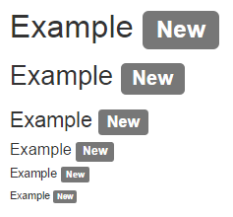

Badge and label
<a href="#">News <span class="badge">5</span></a><br> <a href="#">Comments <span class="badge">10</span></a><br> <a href="#">Updates <span class="badge">2</span></a>
<h1>Example <span class="label label-default">New</span></h1> <h2>Example <span class="label label-default">New</span></h2>
Use span to add this badge to a link
.label-default, .label-primary, .label-success, .label-info,.label-warning or .label-danger, within a <span> element to create a label

Slide 69
forms

Slide 70
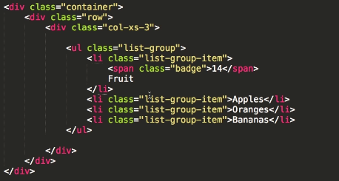
List group
Try to make disable and active

Slide 71
dropdown

Slide 72
The Scrollspy Plugin
And navbar

Slide 73
Carrousel

Slide 74
modal
Tooltip Plugin
Popover Plugin

Slide 75
Day 1 | day2 | day3 | day4 | day5 | day6
Html

Slide 76
Setting un your computer

Slide 77
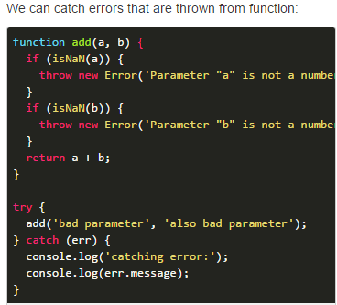

Diagram of how JavaScript works
var answer = prompt("Question to the user");
Names and this java does eplain why we use () and why we use ; and that ‘’ is for text and not for math numbers , java return true y flase of formulas with > <, explain all the type of variables, lowerCamelCase, operators % (Modulus)
++ (Increment)
-- (Decrement)
Explain operators , ( == equal value , === equal value equal type) != , !== not equal value not equal type, +=, -= , string variable , single or doble quates is the same ‘’ “”, merge words with plus eperators
String , aja methods : replace (), concatenate strings, string + number = string, float variables ( number with decimals), toFixed(round results), console.log(somethingWeird.toFixed(1, return string));, parseFloat() convert to number from string,
Boolean variabel
Notice that we define variable names with prefix is andhas. Adding prefix to boolean variable is a good practice.
Ineraction of them , method , class, object oriented programming

Slide 78
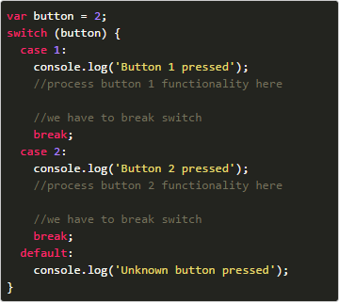

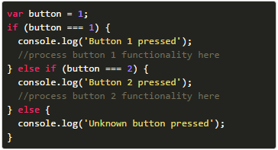
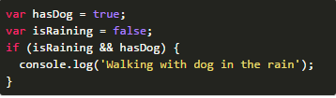
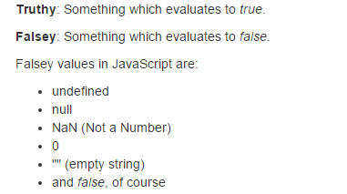
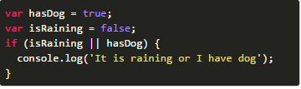
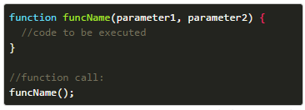



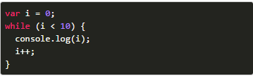
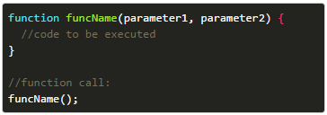
//
Two dimentional array and jagged arrays.
Arrays are list of values. Arrays can contain strings, numbers, booleans, functions and objects. var names = ['Josh', 'Peter', 'Tom']; console.log(names[0]); //Accessing non existing item console.log(names[3]);
We can add new item into array with function push():
var names = ['Josh', 'Peter', 'Tom'];
console.log(names[1]);
//rename Peter to John
names[1] = 'John';
console.log(names[1]);
We can find out how many items are in array with property length:
var fruits = ['apple', 'orange', 'banana'];console.log(fruits[1]);
Good
if (someValue) {
//condition code
}

Slide 79
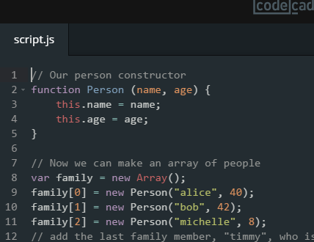
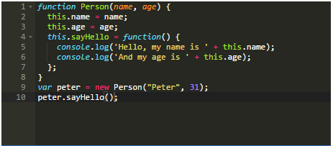
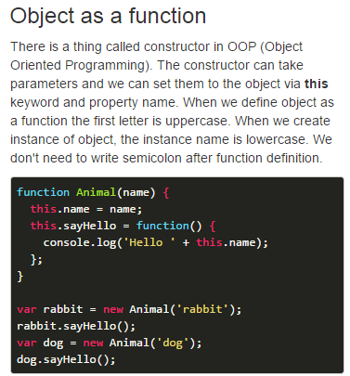
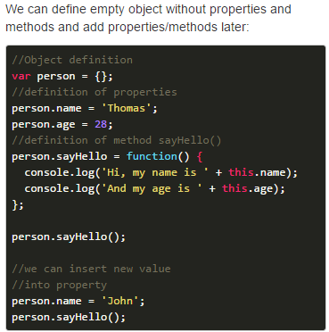
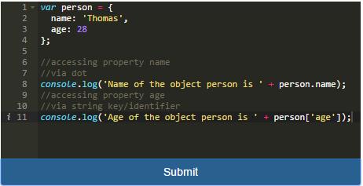
Objects in programming languages simulates objects in real life - animals, cars, people,...
Each object can have attributes/properties, methods (what object can do) and they can inherit attributes and methods from other objects.
We define object name as variable name. Then we open object with {. We assign value to properties with colon.We separate properties and methods by coma. Methods are classic functions that can take parameters. We don't write coma after the last property/method. We end definition of object with } and semicolon.
We can access properties and methods via dot.
Notice, we can access properties inside method via keyword this. this refers to the current object.
You can imagine methods as actions. A person can say hello with method sayHello. Or we could define a methodbark for object dog:

Slide 80
Array – list
You can put integer, float , Boolean, arrays, functions and objects
Declaration
2
Var array = ["Saab", "Volvo", "BMW"];
Array Properties and Methods
var cars = new Array("Saab", "Volvo", "BMW");
.length;
.push(“newEelement");
fruits[fruits.length] = "Lemon";
In JavaScript, arrays use numbered indexes.
In JavaScript, objects use named indexes.
Access de element of an array
Cars[xposition];
Cars[xposition] = “change the content”;
Amount of options to declare

Slide 81
Objects
2
var object = {
};
Call an object property and methods
Object
Object.property;
Object.function();
object = new Object();
Property
Methods
2
2
Name: “juan”;
Age: 23;
methodName : function() { code lines
};
objec.name = “juan”;
Object.age = 23;
Object.methodName = function() {
Code lines
};
This is hoe to Add property ones the object is already created
This is how to Add Methods ones the object is already created
Amount of options to declare

Slide 82
Objects prototype/class
Prototype
This is a object as function
Always with capital letter
this.property/method is very important because then it makes each onject be created with this propertyes
Use the prototype, gives al the functions of that object( you can see this like a class)

Slide 83
Objects prototype/class – example 2

Slide 84
Objects

Slide 85
Connect with HTML

Slide 86
oop
http://javascript.info/tutorial/oop
The 3 pillars

Slide 87
HEROKU
https://www.heroku.com/

Slide 88
Economics is the social science that seeks to describe the factors which determine the production, distribution and consumption of goods and services.
Economics is the social science that seeks to describe the factors which determine the production, distribution and consumption of goods and services.
Economics is the social science that seeks to describe the factors which determine the production, distribution and consumption of goods and services.

